Slide 1

CSC475: Numerical Computing
Tanveer Ahmed Siddiqui

Slide 2

Goals/Objectives
Apply numerical methods/algorithms to obtain approximate solutions to complex mathematical problems.
These complex mathematical problems arises in all fields of:
Engineering
The physical sciences
Life sciences
Scientific computations

Slide 3
Our journey towards these objectives(syllabus)
4) Polynomial interpolation
2) Solution of non-linear equations
7) Numerical integration and differentiation*
5) Linear Regression
6) Splines
3) Solution of linear algebraic systems
8) IVB & BVP*
1) Error Analysis

Slide 4
Start of our journey
WELL, WE HAVE ARRIVED. It was a long road. Not as long as it took humanity to travel from ERROR ANALYSIS, which opens this lecture series, to the latest developments in Numerical Computing, but it was long enough.
So let us now take a last look at what we have learned during the journey.

Slide 5
UNIT 01
Introduction(What, Where, Why)
Error Analysis
Lecture 1-2
Assessment Criteria: Define error, stability, machine precision concepts and the inexactness of computational approximations.

Slide 6
What is Numerical Methods?
“Numerical Methods are techniques by which complex mathematical problems are formulated so that they can be solved with arithmetic and logical operations”.
  Because digital computers excel at performing such operations, numerical methods are sometimes referred as “computer mathematics”.
The approach involves, in most of the cases, formulation of mathematical models of physical situations that can be solved with arithmetic operations
It requires development, analysis and use of algorithm

Slide 7
Scope of Numerical Analysis
Some applications where Numerical methods applied
Natural sciences
Social sciences
Engineering
Medicine
Business.(in financial industry)

Slide 8
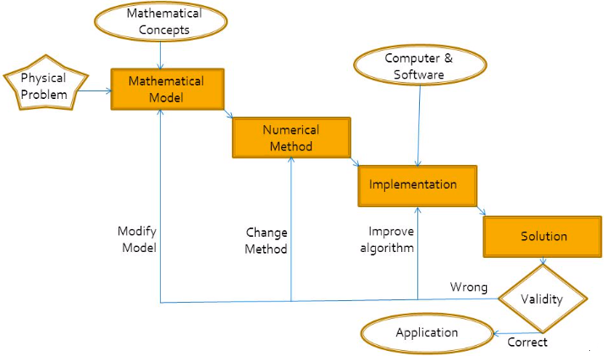
Numerical Computing Process

Slide 9
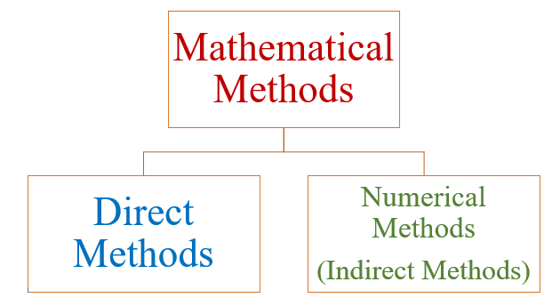
Types of NM
Numerical computations play an indispensable role in solving real life mathematical, physical and engineering problems.

Slide 10
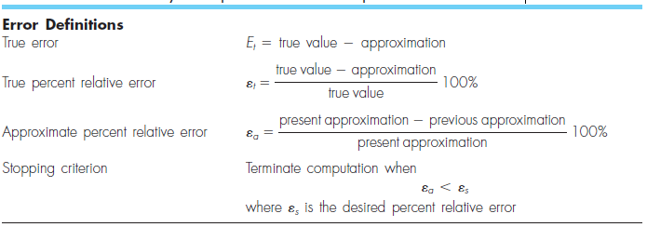
Summary of important information presented in Unit-1
,

Slide 11
UNIT 02
Numerical Methods for Solving
Nonlinear Equations
Lecture 3-5
Assessment Criteria: Apply the Bisection, Regula Falsi, Newton Raphson, Secant and Iteration methods to solve a non-linear (transcendental) equations.

Slide 12
Numerical Methods for Solving Non-Linear Equations
In Lecture 3-5, the techniques for the numerical solution of algebraic and transcendental equations have been presented.
Numerical methods involving iterative solution of nonlinear equations are more powerful.
These methods can be divided into two categories:
  Direct methods
  Indirect (or iterative) methods.

Slide 13
Numerical Methods for Solving Non-Linear Equations
The indirect or iterative methods are further divided into two categories:
  Bracketing methods
  Open methods.
The bracketing methods require the limits between which the root lies, whereas the open methods require the initial estimation of the solution.
Bisection and False Position methods are two known examples of the bracketing methods.

Slide 14
Numerical Methods for Solving Non-Linear Equations
Among the open methods, the Newton-Raphson and the method of Successive Approximation are most commonly used.
The Bisection method, the method of False Position, and the method of Successive Approximations converge linearly while the Newton-Raphson method converges quadratically.
Newton-Raphson method requires less number of iterations than the other three methods.
The Successive Approximation method converges only when the condition |φ′(x)| < 1 is satisfied.

Slide 15
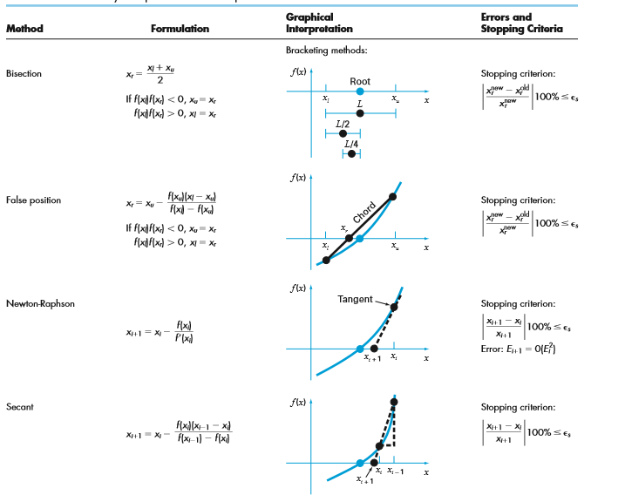
Numerical Methods for Solving Non-Linear Equations

Slide 16
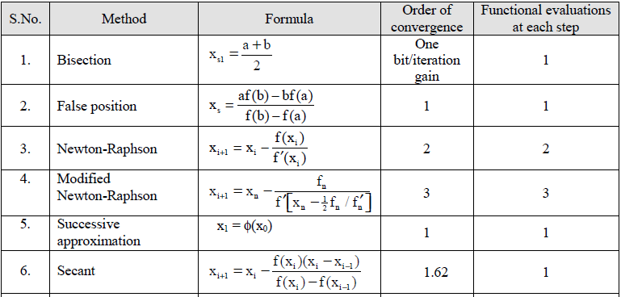
Comparison of the methods

Slide 17
UNIT 3-4
Solution of
System of Linear equation
Lecture 6-10
Assessment Criteria: Apply direct and iterative methods to solve system of linear equations.

Slide 18
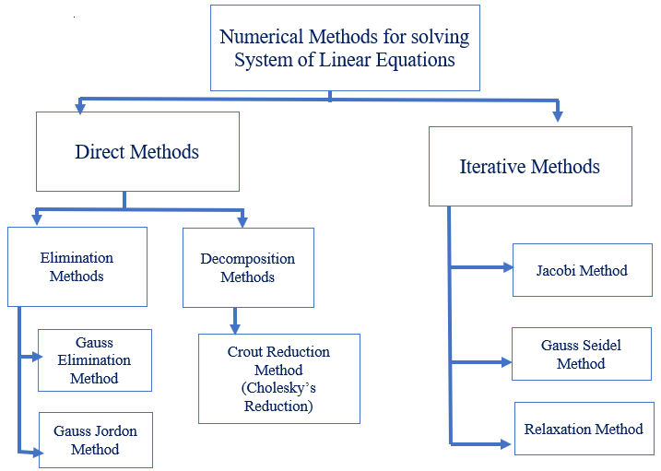
Numerical Methods for Solving System of Linear Equations

Slide 19
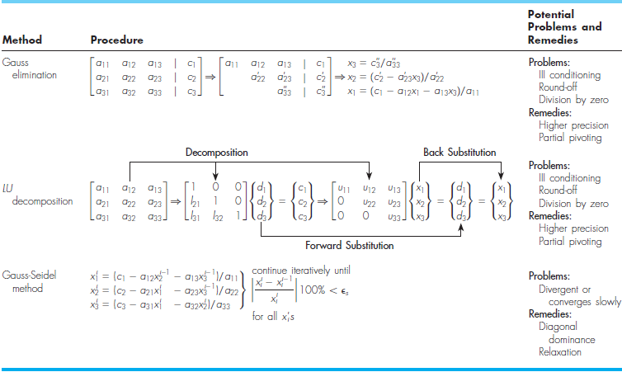
Numerical Methods for Solving System of Linear Equations

Slide 20
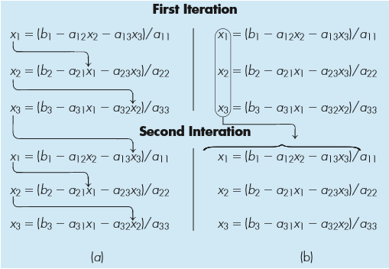
Jacobi and Gauss-Seidel Iterative Methods

Slide 21
UNIT 5-7
Difference Theory, Interpolation, and Regression
Lecture 12-19
Assessment Criteria: Apply interpolation, extrapolation, and regression algorithms for approximating functions.

Slide 22
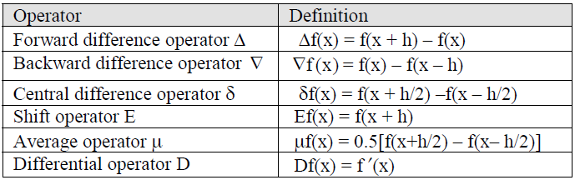
Difference Operators
,
In previous lectures, we discussed following difference operators:

Slide 23
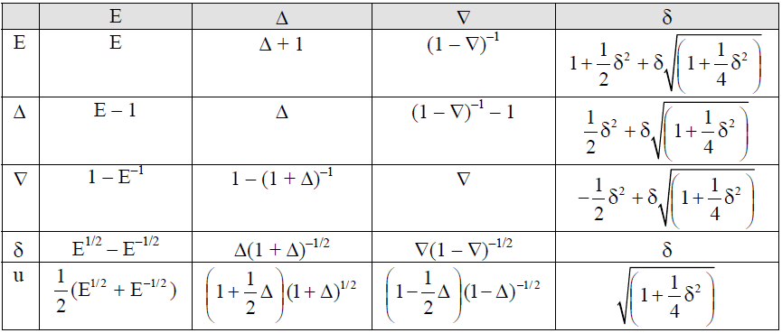
Relationship between difference operators
,
The relationships among the various operators are shown in following table:

Slide 24
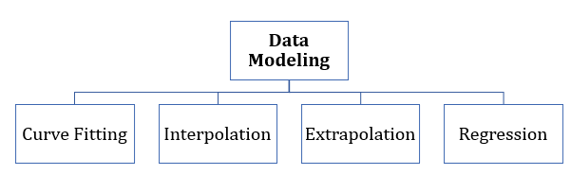
Data Modeling
,

Slide 25
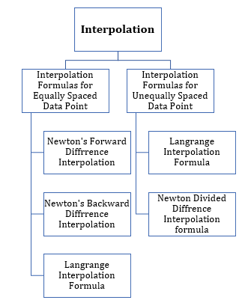
Interpolation
,

Slide 26
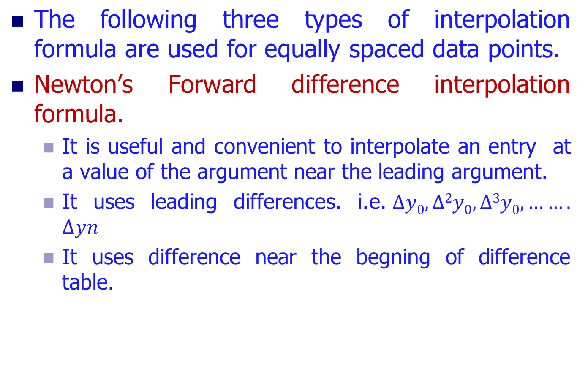
Types of interpolation formulas for equally spaced data points

Slide 27
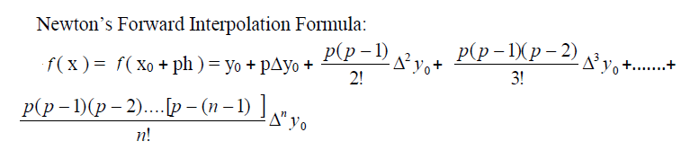
Newton’s forward difference formula for interpolation

Slide 28
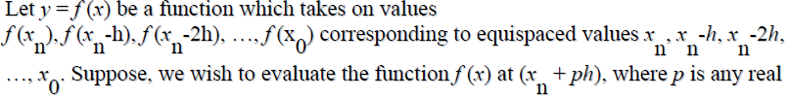

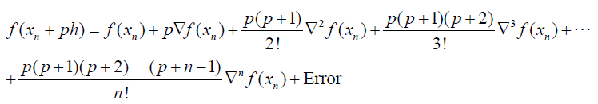
Newton’s backward difference formula for interpolation

Slide 29
Types of interpolation formulas for equally spaced data points
Central difference interpolation formula.
  These formulas employ differences in the centre of the difference table.
  The following central differences are commonly used:
    Stirling’s formula
    Basse’ls formula
    Everet’s formula
    Gauss forward and backward formulas.

Slide 30
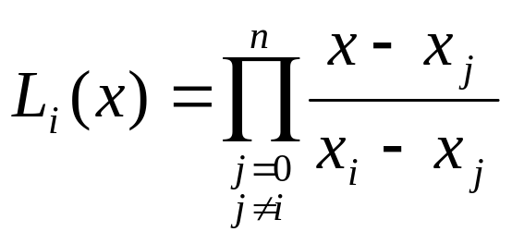


Lagrange functions
The Lagrange function is given below.
i=0,1,……n
Solution:
Since we have two points, therefore we have to find the Lagrange function(polynomial) of first degree from given points.
Here i = 0 and 1, so we find L₀(x) and L₁(x)

Slide 31

Lagrange functions
These polynomials have the following properties:
L₀(x₀)=1 L₀(x₁)=0
L₁(x₀)=0 L₁(x₁)=1
i.e.
the Kronecker delta function.

Slide 32
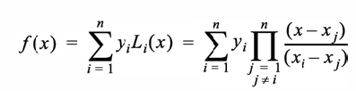

The Lagrange Polynomial: The General Case
Then P(x) =f₀L₀(x)+f₁L₁(x)+…f_{n}L_{n}(x)
We would have P(x_{k})=f_{k} for k=0,…,n.
P(x) is called the nth Lagrange interpolating polynomial.
The above equation can be written in a compact form using summation and product notation as:
Where are called the Lagrange
functions.

Slide 33
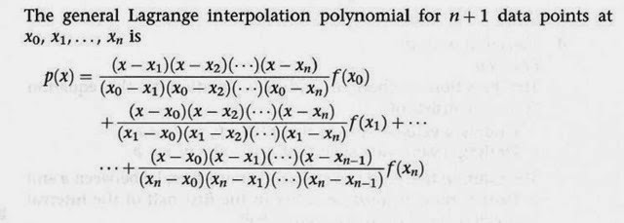
The Lagrange Polynomial: The General Case

Slide 34

Divided Differences
When the arguments are not equi-spaced, we use divided differences.
Let y = f(x) be a function whose functional form is not known but its values at (n+1) points, namely, x₀ , x₁, … x_{n} are known.
The divided difference of first order for the points x0, x1 is defined as:
This is the discrete version of the derivative of a function f(x).

Slide 35
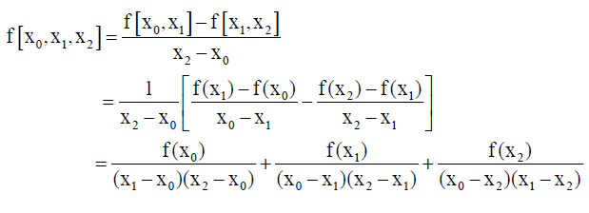
2nd Divided Differences
For the points x₀, x₁, x₂ the divided difference of second order is defined as

Slide 36
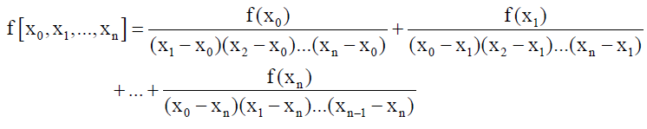
n^{th} Divided Differences
In the similar manner, the divided difference of nth order for the points x₀, x₁ , … x_{n} is defined as:

Slide 37
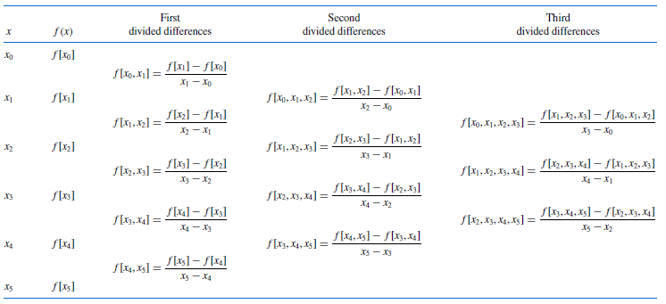
Divided Difference Table
The divided difference tables with 6 arguments are as follows:

Slide 38
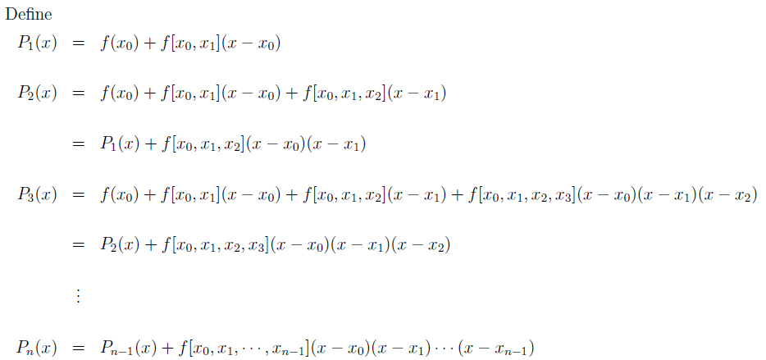
NDD Interpolation
Newton’s Divided Difference Interpolating Polynomial Or Newton’s Form

Slide 39
NDD Interpolation
The polynomial Pn is called Newton’s divided deference formula for the interpolating polynomial or Newton’s form for the interpolating polynomial.
Note that P_{n}(x_{i}) = f(x_{i}).

Slide 40
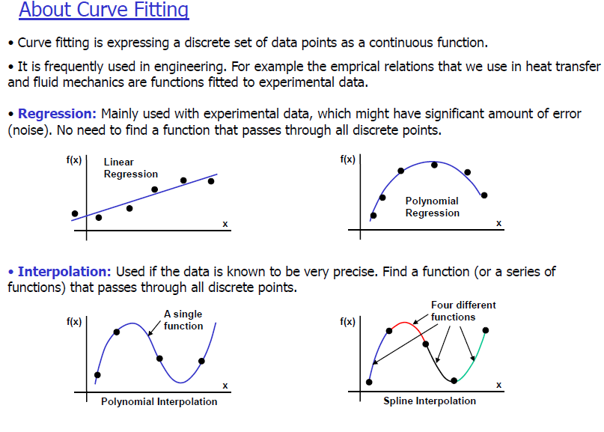
Difference between Curve fitting, Regression, and Interpolation

Slide 41
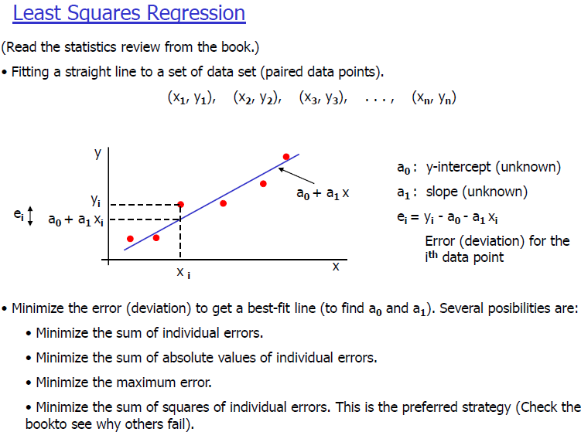
Simple Linear Regression Model

Slide 42
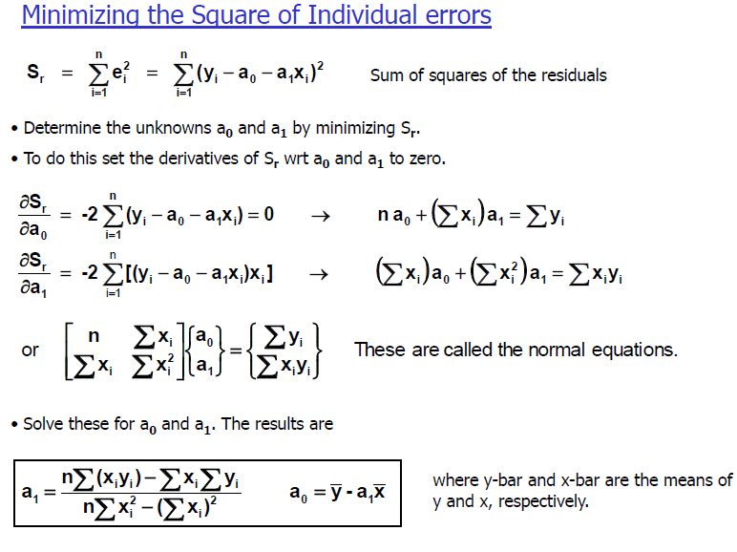
Simple Linear Regression Model

Slide 43
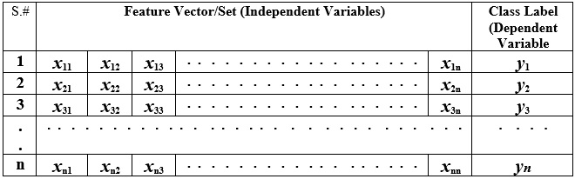
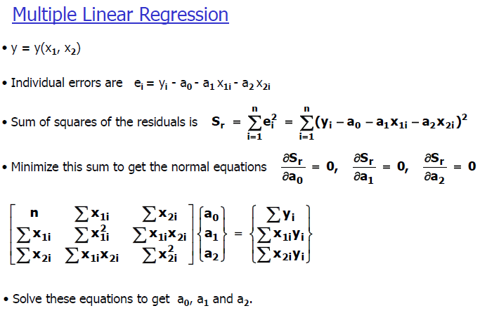
Multiple Linear Regression Model

Slide 44
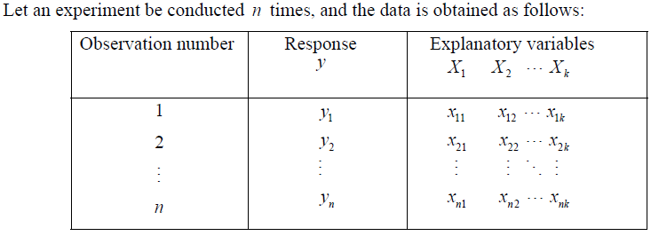
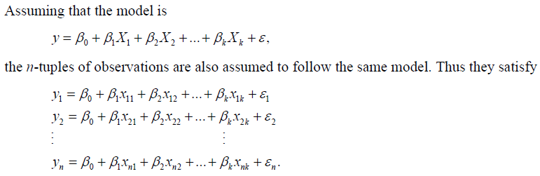
Model Setup: MLR

Slide 45
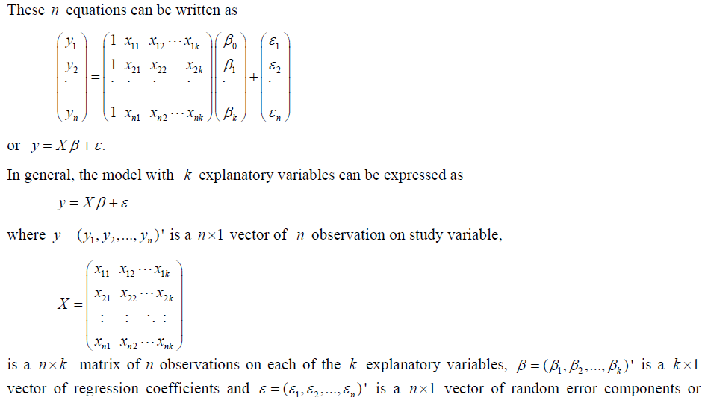

Model Setup: MLR

Slide 46
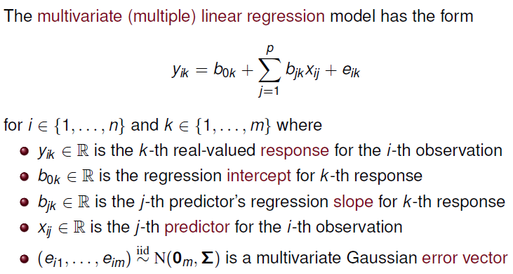
MvLR Model: Scalar Form

Slide 47
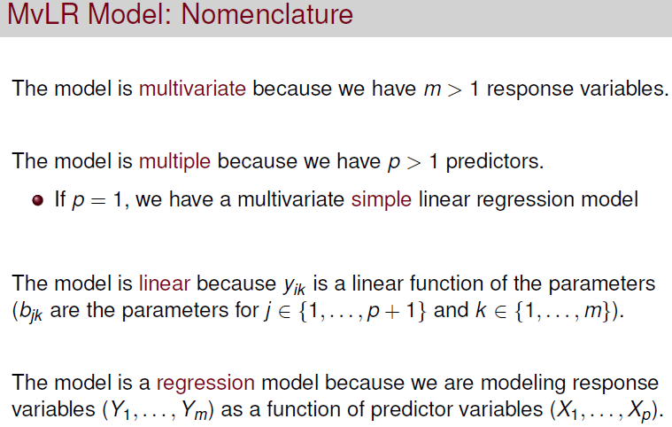
MvLR Model: Scalar Form

Slide 48
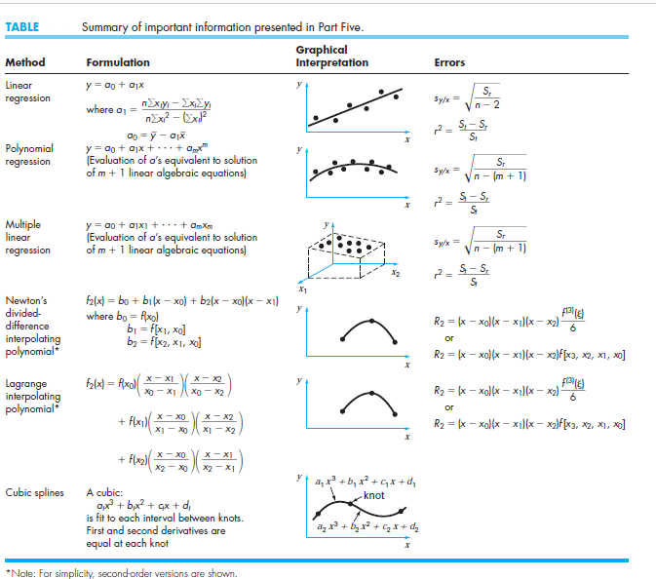
Recap
,

Slide 49
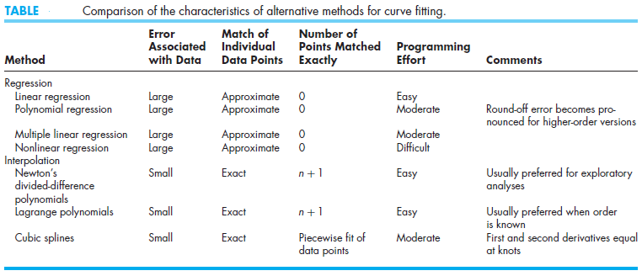
Recap
,

Slide 50
UNIT 8
Numerical Differentiation
Lecture 22-24
Assessment Criteria: Apply algorithms for differentiation to practical problems

Slide 51
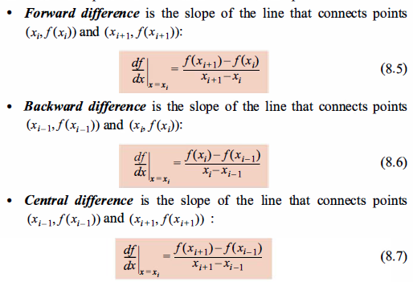
Differentiation using forward difference operator
The derivative is estimated as the value of the slope of the line that connects the two points.

Slide 52
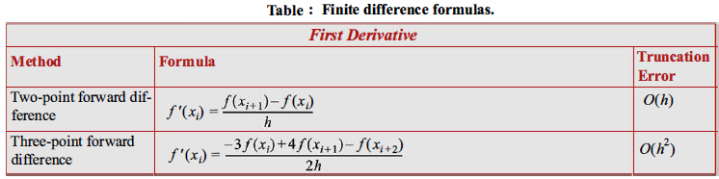
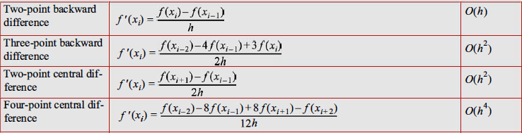
Finite difference formulas using Taylor Series expansion

Slide 53
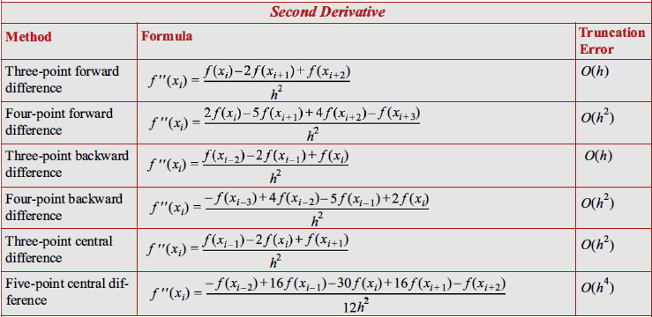
Finite difference formulas using Taylor Series expansion

Slide 54
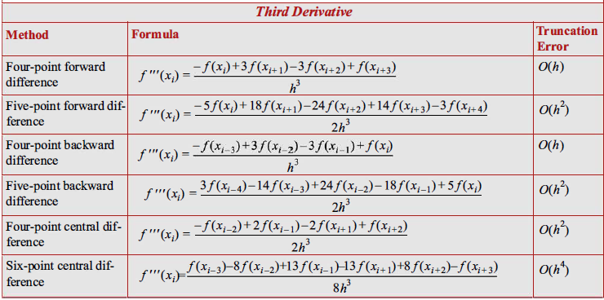
Finite difference formulas using Taylor Series expansion

Slide 55
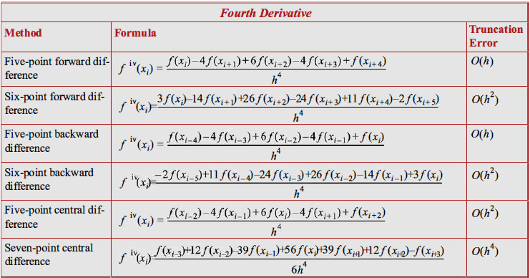
Finite difference formulas using Taylor Series expansion

Slide 56

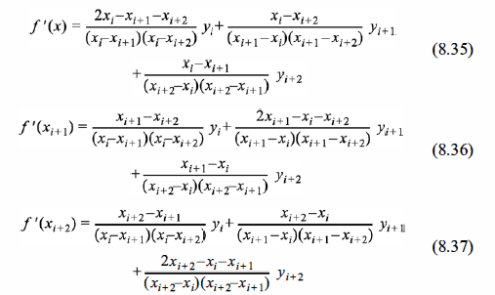
Differentiation formulas using Lagrange polynomials

Slide 57
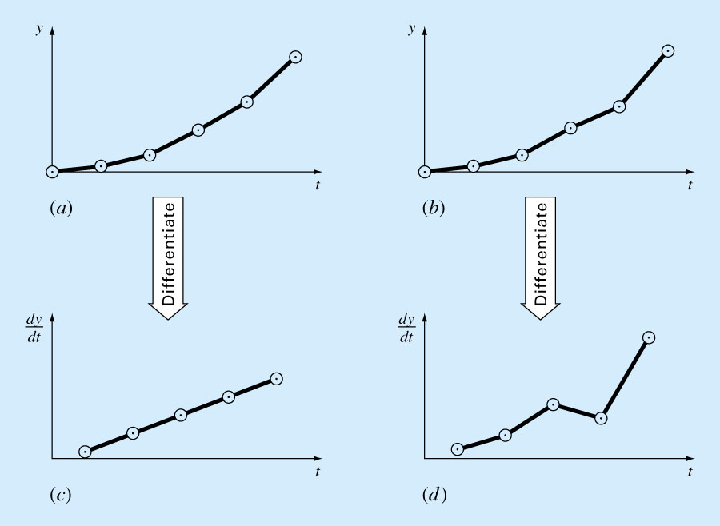
Differentiation of Noisy Data

Slide 58
UNIT 9
Numerical Integration
Lecture 25-27
Assessment Criteria: Apply algorithms for integration to practical problems

Slide 59
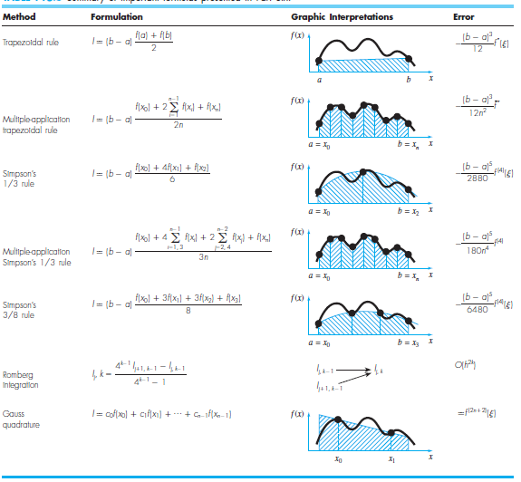

Slide 60
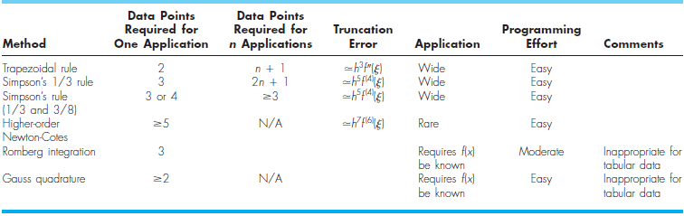

Slide 61
UNIT 10
Numerical Methods for Solving
Ordinary Differential Equations:
Initial-Value Problems
Lecture 28-30
Assessment Criteria: Apply algorithms for Ordinary Differential Equations to practical problems

Slide 62
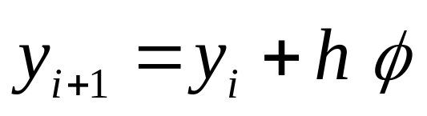

Differentiation using forward difference operator
The methods discussed in this Unit have the general form:
Different forms of will be used for the Midpoint and Heun’s Methods.

Slide 63
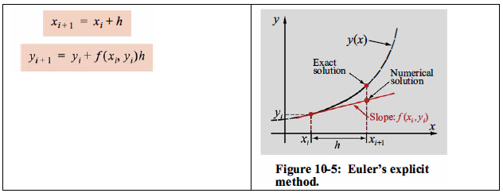
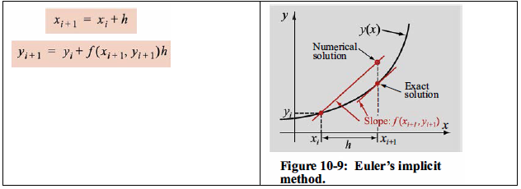
Euler's Explicit and Implicit Methods
Euler's Explicit Method
Euler's Implicit Method

Slide 64
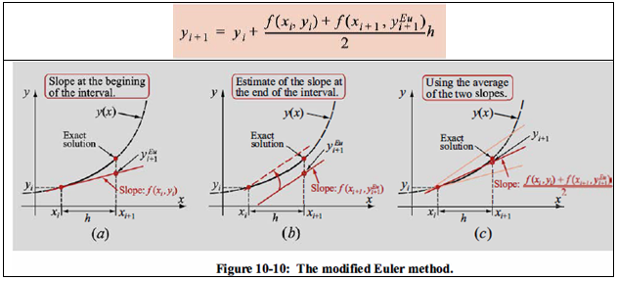
Modified Euler's Method
MODIFIED EULER'S METHOD

Slide 65
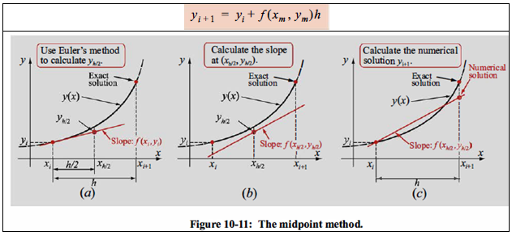
Mid Point Method
MIDPOINT METHOD

Slide 66


Slide 67
NMs for Solving ODE
For remaining methods, see chapter 10 of Reference Book.

Slide 68
The SALT of Life
Mathematics is a Science; it is an Art, it is a precise and concise Language; and it is a great problem solving Tool. Thus mathematics is the SALT of life. As food is tasteless without salt so life is tasteless without mathematics. You will see that mathematics is really fun, so enjoy the beauty and power of mathematics by designing ALGORITHMS.
TANVEER AHMED(2009)

Slide 69
So, whichever direction you take in your future journey through the land of algorithms in your studies and your career, the road ahead is as exciting as it has ever been. Not many areas of science and engineering can make this claim with the same assurance that algorithmics can.
Have a great trip!

Slide 70
Exam Preparation

Slide 71


Slide 72


